Slide 1
Hazard Recognition in
Scrap Recycling
Susan Harwood Training Grant
2016

Slide 2
Disclaimers
This material was produced under grant number SH-29653-SH6 from the Occupational Safety and Health Administration, U.S. Department of Labor. It does not necessarily reflect the views or policies of the U.S. Department of Labor, nor does mention of trade names, commercial products, or organizations imply endorsement by the U.S. Government.
This training is not intended to replace site or company specific training on the recognition and control of hazards in the workplace.
Photos shown in this presentation may depict situations that are not in compliance with applicable OSHA/safety requirements.
It is the responsibility of the employer and its employees to comply with all pertinent OSHA/safety rules and regulations in the jurisdiction in which they work.

Slide 3
Introduction
Who am I & Why are we here today
Who is ISRI, OSHA, Susan Harwood
WiiFM or What’s in it for me?
Safety issues in scrap recycling
  Mobile Equipment safety – Housekeeping & Fire Prevention – Lockout/Tagout – Hazard Communication – Personal Protective Equipment
Accidents/Incidents
Hazard Recognition
Job Hazard Analysis (JHA) understanding & development

Slide 4
Learning Objectives
In this class you can expect to learn the following:
How to better recognize hazards in your workplace
Understanding safety around mobile equipment
Fire prevention methods
How to follow the lock out tag out process
How to recognize and understand Safety Data Sheet (SDS) pictograms
How to read and understand a Safety Data Sheet
How to do a Personal Protective Equipment job hazard assessment

Slide 5
OSHA’s Mission
With the Occupational Safety and Health Act of 1970, Congress created the Occupational Safety and Health Administration (OSHA) to assure safe and healthful working conditions for working men and women by setting and enforcing standards and by providing training, outreach, education and assistance.
Notes:
OSHA’s mission
Assure safe and healthful workplaces, and preserve human resources
Establish training programs
Develop mandatory job safety and health standards and enforce them effectively

Slide 6

OSHA and your rights
In the event of:
Firing of laying off
Blacklisting
Demoting
Denying overtime or promotion
Disciplining
Denial of benefits
Failure to hire or rehire
Intimidation/harassment
Making threats
Reassignment affecting prospects for promotion
Reducing pay/hours
You have protection
Notes:
This is the point to discuss employee/employer rights and responsibilities and whistleblower protection
Whistleblower protection - https://www.whistleblowers.gov/wb_filing_time_limits.html
Section 11(c) of the Occupational Safety & Health Act (OSHA). [29 U.S.C. §660(c)] Section 11(c) provides protection for employees who exercise a variety of rights guaranteed under the Act, such as filing a safety and health complaint with OSHA, participating in an inspection, etc.
Employees have 30 days to file in the event of these adverse actions of employers.
PROTECTION FROM WORKPLACE RETALIATION
Protection from workplace retaliation means that an employer cannot take an "adverse action" against workers, such as:
Firing or laying off
Blacklisting
Demoting
Denying overtime or promotion
Disciplining
Denial of benefits
Failure to hire or rehire
Intimidation/harassment
Making threats
Reassignment affecting prospects for promotion
Reducing pay or hours

Slide 7

OSHA code of federal regulations
http://www.osha.gov
Notes:
Where to find the information

Slide 8
Incident
An unplanned, unwanted, but controllable event which disrupts the work process and causes injury to people or damage to property.
Notes:
Most everyone would agree that an incident is unplanned and unwanted. The idea that an incident is controllable might be a new concept. An incident stops the normal course of events and causes property damage, or personal injury, minor or serious and occasionally results in a fatality.

Slide 9
Near Miss
An unplanned and unwanted event which disrupts the work process and has the potential of resulting in injury, harm, or damage to persons or property.
Notes:
A near miss incident disrupts the work process, does not result in injury or damage, but should be looked as a “wake up call”. Could be thought of as the first of a series of events which could lead to a situation in which harm or damage occurs. Employers should investigate an incident to determine the root cause and use the information to stop process and behaviors that could just as easily have resulted in an incident.
Ask audience for example of real near misses that has occurred at their workplace. Then say: We will discuss why a policy that encourages resolution of incidents, near-misses, will be worth the time and effort.

Slide 10
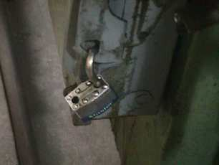
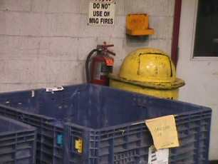
Hazard Recognition
Notes:
Before starting this section show video titled Hazard Recognition (11’ 14”).

Slide 11
What is a Hazard?
A hazard is a situation, an item, or a condition that is potentially dangerous. A hazard might endanger the health and/or safety of workers, contractors, or the general public.
Hazards may look nonthreatening, but they have the potential to result in injury, illness or loss of life and/or property within certain conditions, and are described as incidents looking for a place to happen.
Most hazards are foreseeable and, therefore, preventable if safety measures are implemented and hazards are diligently reported and dealt with.
(Hazard Recognition Checklists)
Notes:
Discuss these talking points and give the “Safety in the Workplace” checklist handout to the group. This check list covers the main sections of this course. Giving the checklist out at this point will give those in the class good discussion points throughout the rest of the day. The sections will cover: Housekeeping, Fire Prevention, LOTO, PPE, Hazard Communication, and Mobile Equipment Safety. Tell those in the room to use this checklist as a reference tool throughout the day. And also to bring it back to their worksites to use as a reference tool on a daily basis.
While the checklists may not cover everything that could possibly be considered a hazard in the workplace they will help the student to begin to see their workplace from a hazard recognition POV.

Slide 12
Why is Hazard Recognition Important?
Poor health and safety conditions can cause property damage, increase costs and result in incidents. Recognizing and correcting hazards can greatly reduce the risk of workplace incidents and overall help to ensure worker safety.
Notes:
Safety is the identification of hazards and the reduction of risk. That’s what it’s all about!
How can you help?
Those in charge of assessing the hazards in a workplace scrutinize items, conditions and situations that could potentially pose a risk to employees, contractors and/or the general public. They look at situations and conditions and think about what could potentially go wrong that could or would result in loss of life, loss of work days, loss of productivity, loss of property, injuries or sickness.
Hazard assessments look realistically at every task in the workplace and its inherent dangers. Then it sets out to make each task as safe as possible.
What are the typical hazards we see?
Whenever machinery is being used there is danger of a malfunctioning machine, unsafe operation, unsafe clothing for machine operation, untrained workers, or poor working conditions for operating machinery.
If the workplace involves movement of vehicles, there are potential dangers. Poor housekeeping may pose a danger because the workplace has not been kept cleared and employees do not see materials that are in the traffic area.

Slide 13
Tips for Hazard Recognition
Create a plant inspection team.
Try to include someone on your team who doesn’t work in this area all the time.
Divide the assessment area into sections.
Do a pre-assessment preparation.
Monthly inspections are necessary, but they are no substitute for daily checks.
Be sure to communicate the results of your findings.
Notes:
Try to include someone on your team who doesn’t work in this area all the time. Things that would be picked up as hazards by a fresh pair of eyes become overlooked problems if you work with them every day.
Divide the assessment area into sections. These may include: offices, receiving, shipping, manufacturing, customer service, processing.
Do a pre-assessment preparation. Start by collecting information about previous inspections and recommended changes. Look at information from work hazard reports, recommendations from your Safety Committee, and maintenance reports.
Monthly inspections are necessary, but they are no substitute for daily checks. Daily inspections look for hazards.
Create a plant inspection team. The members should be as close to field operations level as possible. They are the ones who work with these potential hazards every day. Ultimately the employer is responsible for the prevention of injuries, illness, and loss, but workers in the field have the most immediate understanding of conditions.
The hazard recognition committee’s job is to note hazards. Whether these have yet to cause an injury, illness, or loss is not part of this committee’s consideration.
The committee should inform employees and managers of the upcoming hazard assessment. Identify hazards on site by inspection, but also by talking to workers and having them demonstrate how a process or piece of equipment or safety procedure works.
Be sure to communicate the results of your findings.

Slide 14
Quiz – Hazard Recognition
Anything that has the potential to cause harm to people, damage to property or environment, or loss to process is called what?
  A mistake
  A hazard
  Excessive noise
  All of the above
Notes:
B. – A hazard

Slide 15
Quiz – Hazard Recognition
Pre-use inspections provide you with the opportunity to identify hazards and correct them before beginning any task.
True or False
Notes:
TRUE
Question 4 on Pre/Post Test

Slide 16
Quiz – Hazard Recognition
Effective hazard recognition can be the difference between a near miss event and a very serious injury, or even a fatality.
True or False
Notes:
TRUE

Slide 17
Quiz – Hazard Recognition
A Job Hazard Assessment (JHA) is an example of a procedure that can be created from information gathered during a risk assessment of the working area.
True or False
Notes:
TRUE
Question 14 on Pre/Post Test

Slide 18
Quiz – Hazard Recognition
Which of the following requires an inspection to be completed prior to use on each shift?
  Forklifts
  Overhead Cranes
  All other forms of mobile equipment
  All of the above
Notes:
D. – All of the above

Slide 19
Do you see any hazards here?

Slide 20
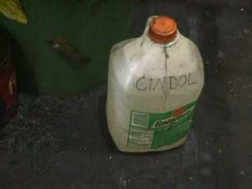
Notes:
Poor labeling. Is CINDOL someone’s name? Is it the chemical that is in this container? Is there Gatorade in this container?
1910.1200
Hazard Communication
29 CFR 1910.1200(f)(5)(ii) states that all chemical containers must be labeled with the chemical’s name and hazard(s).

Slide 21
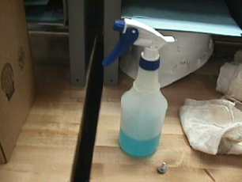
Notes:
1910.1200
Hazard Communication
29 CFR 1910.1200(f)(6)(ii) states that all chemical containers must be labeled with the chemical’s name and hazard(s).

Slide 22
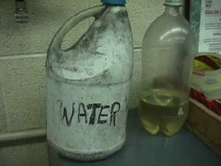
Notes:
1910.1200
Hazard Communication
29 CFR 1910.1200(f)(6)(ii) states that all chemical containers must be labeled with the chemical’s name and hazard(s).

Slide 23
Notes:
1910.147
Lockout/Tagout
29 CFR 1910.147(c)(5)(ii)(A-D) state that lockout/tagout locks must be in place and identified at all times.

Slide 24
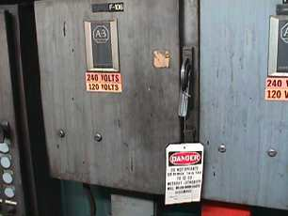
Notes:
1910.147
Lockout/Tagout
29 CFR 1910.147(c)(3)(ii): “In demonstrating that a level of safety is achieved in the tagout program which is equivalent to the level of safety obtained by using a lockout program, the employer shall demonstrate full compliance with all tagout-related provisions…”

Slide 25
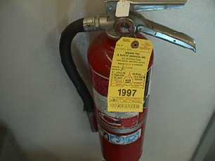
Notes:
1910.157
Portable Fire Extinguishers
29 CFR 1910.157(e)(2) states that fire extinguishers shall have a documented inspection annually.

Slide 26
Notes:
1910.157
Portable Fire Extinguishers
29 CFR 1910.157(c)(1) states that the employer shall maintain fire extinguishers at identified, readily accessible locations.

Slide 27
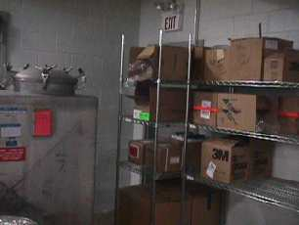
Notes:
1910.37
Means of Egress
29 CFR 1910.37(f)(1) states that exits shall be readily accessible at all times.

Slide 28
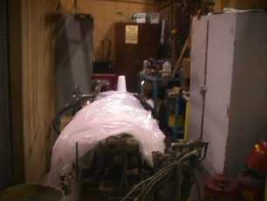
Notes:
1910.22
Walking-Working Surfaces
29 CFR 1910.22(a)(1) states that all working spaces shall be kept clean and orderly.

Slide 29
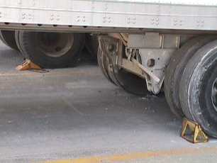
Notes:
1910.178
Powered Industrial Trucks
29 CFR 1910.178(k)(1) states that brakes of highway trucks shall be set and wheel chocks placed under the rear wheels to prevent the trucks from rolling while they are boarded with powered industrial trucks..

Slide 30
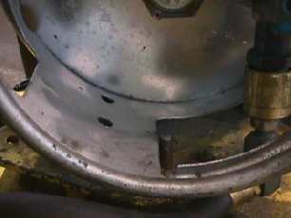
Notes:
1910.178
Powered Industrial Trucks
29 CFR 1910.178(f)(2) states that the storage and handling of liquefied petroleum gas fuel shall be in accordance with NFPA Storage and Handling of Liquefied Petroleum Gases (NFPA No. 58-1969), which is incorporated by reference as specified in Sec. 1910.6.
BEST PRACTICE - where a locator pin is provided for an LP cylinder, it must be used. This will keep the LP tank from unnecessary movement on the powered industrial vehicle.

Slide 31
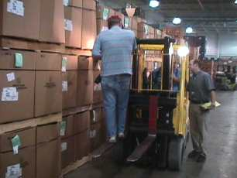
Notes:
1910.178
Powered Industrial Trucks
29 CFR 1910.178(m)(12) states that an industrial truck used for lifting personnel must be equipped with a safety platform.

Slide 32
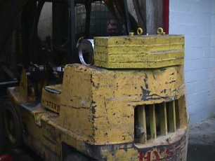
Notes:
1910.178
Powered Industrial Trucks
29 CFR 1910.178(a)(4) states that modifications and additions to forklifts shall not be made without the manufacturer’s prior written approval.

Slide 33
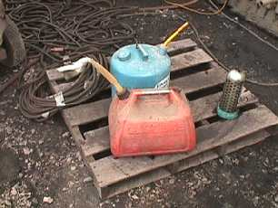
Notes:
1910.106
Flammable/Combustible Liquids
29 CFR 1910.106(d)(2)(i) states that only approved containers and portable tanks shall be used to store flammable liquids, and 29 CFR 1910.1200(f)(5)(ii) states that all chemical containers must be labeled with the chemical’s name and hazard(s).

Slide 34
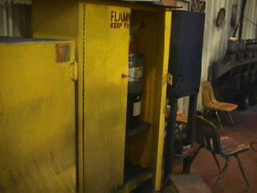
Notes:
1910.106
Flammable/Combustible Liquids
29 CFR 1910.106(d)(3)(ii): “…All joints and seams shall remain tight and the door shall remain securely closed during the fire test. Cabinets shall be labeled in conspicuous lettering, "Flammable - Keep Fire Away.”

Slide 35
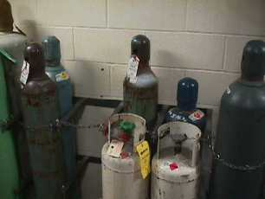
Notes:
1910.253
Oxygen-Fuel Gas Welding & Cutting
29 CFR 1910.253(b)(2)(ii) states that all oxygen cylinders must be stored at least 20 feet from any flammable or combustible materials, or have a five-foot divider between them.

Slide 36
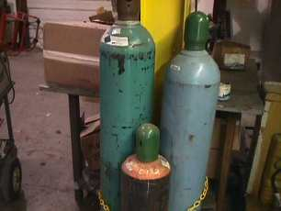
Notes:
1910.253
Oxygen-Fuel Gas Welding & Cutting
29 CFR 1910.253(b)(2)(ii) states that all oxygen cylinders must be stored at least 20 feet from any flammable or combustible materials.

Slide 37
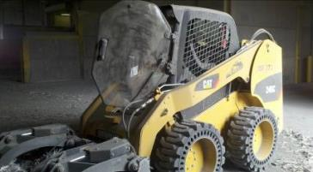
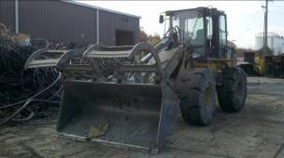
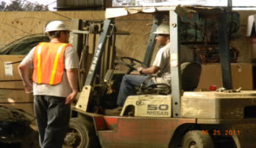
Mobile Equipment Safety
Notes:
Before beginning this section show video titled Working Safely Around Mobile Equipment (15’ 09”).

Slide 38

Hazard Recognition
Notes:
Show video, talk about the scenario (what, where, how) and the outcome.
In this scenario the workers put themselves in a bad position. They should have waited for the customer to finish moving their vehicle before they walked behind it. This was an incident that could have turned into a major injury or worse. Luck played a big part in this situation and no one was injured. The important piece to get across to the viewer is to recognize or identify the hazard of putting oneself in the position of the moving vehicle. Although the employees did not expect this vehicle to come back and hit them workers everywhere must learn to IDENTIFY THE HAZARDS AND REDUCE THE RISKS around their facilities.

Slide 39
Know your surroundings
Do a Walk Around
Inspection
Circle of Safety
Before Operating
The Equipment
Notes:
This slide “Circle of Safety” is about walking around the piece of equipment before operating it. By doing a walk around you are inspecting and looking for people or objects that might be in the blind spots, tires, or under the equipment. All equipment operator should do a 360 degree walk-around inspection at the start of their shift. They should also do a 360 degree walk around of their equipment when they come back from their morning break, lunch or dinner, evening break, etc. This walk-around will give the operator the opportunity to see the BIG PICTURE around their equipment. This is an important and simple step towards recognizing and reducing hazards in the workplace.

Slide 40
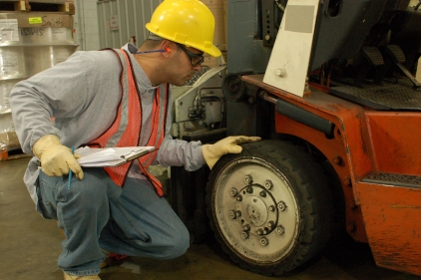
Notes:
Pre-operational inspection. Why do you do this with your equipment? 1) to be sure that the equipment is safe for operation, 2) to check for damage to the equipment.
Why else do we do a pre-operational inspection? A pre-operational inspection is considered a form of hazard recognition. By looking closely at the mobile equipment you may be able to spot “small issues” before they become “larger hazards”.

Slide 41
Safety around Mobile Equipment
How do you communicate with the mobile equipment operators in your facility?
Notes:
Mobile equipment in this case is forklift, skidsteer, wheel loader (typical warehouse mobile equipment).
Do you use hand-held radios or hand signals to communicate with the equipment operators? Either method is acceptable. Clear communication is the KEY lesson here.
The question…”How do you communicate with mobile equipment operators at your facility?” can be answered with a few different options.
Hand held radios
Verbal communications
Body language hand signals
The main point to be made with this slide is that no one shall pass by mobile equipment without getting the operators attention and the operators “ok to pass” signal (verbal or other means).

Slide 42
Safety around Mobile Equipment
What is the safe distance to work or walk around mobile equipment at your facility?
Notes:
The following slides offer a guideline to help the view recognize the blind spots that an equipment operator has. No pedestrian should pass by a piece of operating mobile equipment until they are recognized by the operator and that operator knows the pedestrian’s intention to pass by the equipment. See next several slides for blind spot areas.

Slide 43
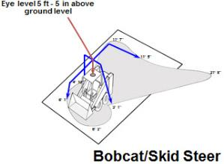
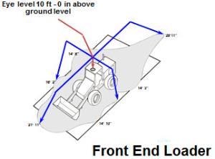
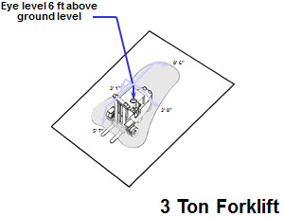
Blind spots

Slide 44
Learn To Know…
The NO-ZONE
THE SHADED AREA SURROUNDING EACH VEHICLE REPRESENTS THE DANGER ZONE or “NO-ZONE” IN WHICH THE VEHICLE OPERATOR’S VIEW OF PEDESTRAN TRAFFIC IS GREATLY REDUCED OR OBSCURRED ALTOGETHER.

Slide 45
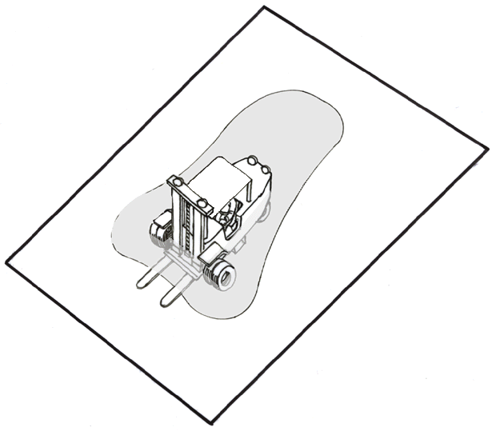
Eye level 6 ft above
ground level
8’ 6”
3’ 1”
3’ 8”
5’ 7”
Forklift

Slide 46
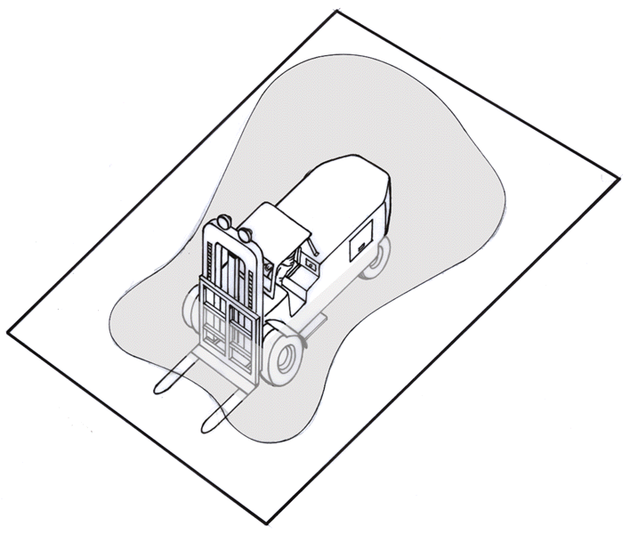
Eye level 8 ft - 8 in above
ground level
13’ 7”
13’ 0”
6’ 4”
9’ 2”
7’ 0”
10 Ton Forklift
10’ 7”
12’ 2”

Slide 47
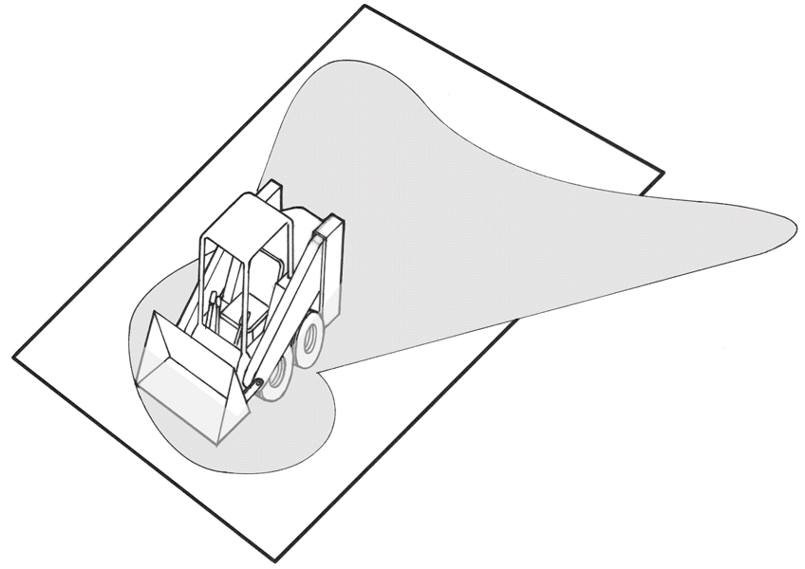
Eye level 5 ft - 5 in above
ground level
11’ 7”
11’ 5”
21’ 8”
4’ 10”
Skid Steer Loader
6’ 1”
3’ 1”
6’ 3”

Slide 48
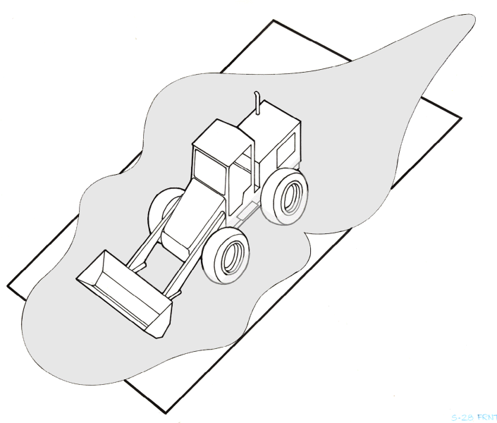
Eye level 10 ft above
ground level
28’11”
14’ 8”
16’ 2”
Front End Loader
14’ 3”
21’ 11”
14’ 10”

Slide 49
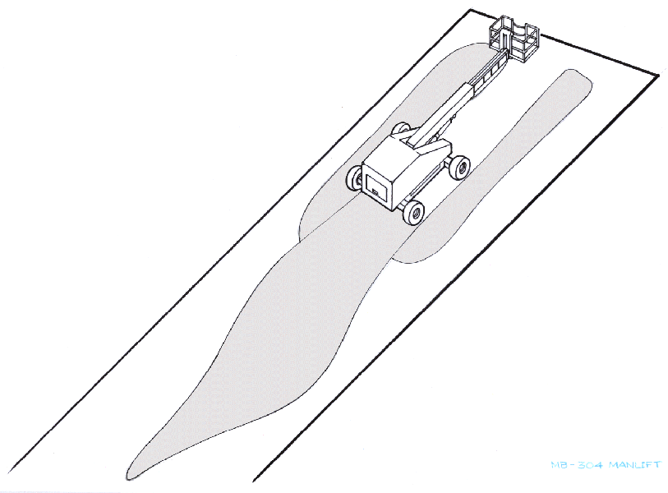
Eye level approximately 10 ft above
ground level
34’ 0”
36’ 4”
Aerial Work
Platform
68’ 0”
95’ 0”

Slide 50
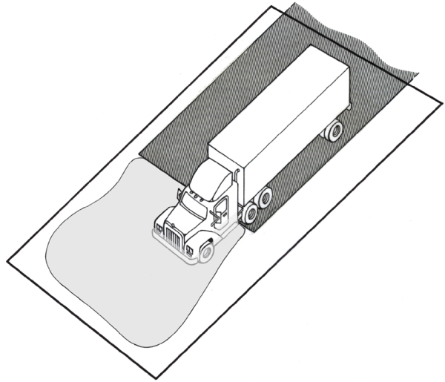
Eye level 6 ft - 10 in above
ground level
Area of fully
obstructed view
27’ 1”
Semi-Truck & Trailer
6’ 5”
42’ 8”
40’ 6”
36’ 8”

Slide 51
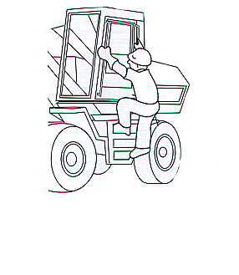
The 3-Point Rule
Climbing into and out of the operator’s seat:
Enter and exit the operator’s seat from the side opposite of the controls.
When climbing in and out of the operator’s seat you must be facing the equipment (as seen in this picture)
Use the 3-Point Rule when climbing into and out of the operator’s seat.
Get on and off of the machine slowly. And do not jump off.
This picture shows the equipment operator using the 3-point rule when climbing on and off of the machine. BE SAFE and USE IT AT ALL TIMES!!!
Notes:
Always use the three point rule when climbing on and off of the equipment. That means that your body will always have three points of contact with the machine. In case you are to slip or lose your balance you will be able to catch yourself if you follow the three point rule.

Slide 52
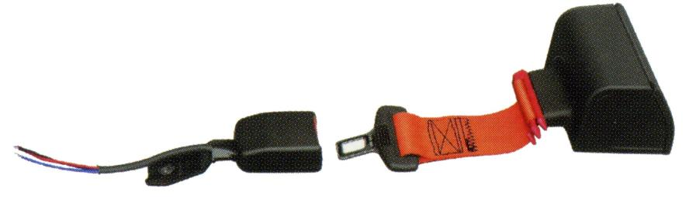
When do you use your seatbelt?
Notes:
When and why do you use the seatbelt?

Slide 53
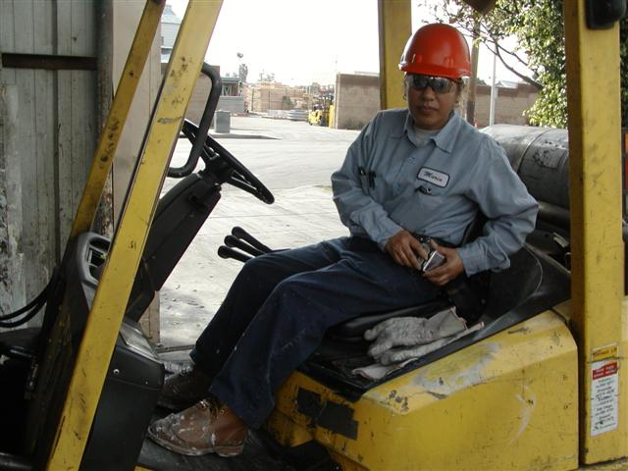
Wear that seatbelt . . . Always!

Slide 54
Understanding your equipment
LIFT TRUCK CENTER OF GRAVITY:
  The stability of your lift truck is determined by the location of its center of gravity.
  The lift truck has moving parts and therefore has a center of gravity that moves.
  The center of gravity moves forward as the mast is tilted forward and backward as the mast is tilted backward.
  The center of gravity moves up when the mast moves up and down when the mast moves down.
P.I.T. Center of Gravity
Notes:
Stability Triangle
Talk about the invisible center of gravity
-how it shifts when you accelerate, brake, and turn
-how if that center of gravity shifts outside of the triangle
then the truck has a very good chance of tipping
Talk here about how operating equipment like this (or loaders, or skid steers, or cranes, etc.) requires that the operator “feel” the control of it. It’s a feel job, and if you can sense how the equipment is moving in your hands, than you will do very well operating it.

Slide 55
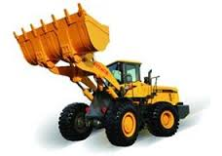

Center of Gravity
Notes:
Static Forces are Affected by:
Load characteristics
Lift height
Amount of tilt
Tire condition
Dynamic Forces are Affected by:
Acceleration
Travel speed
Braking
Surface conditions

Slide 56
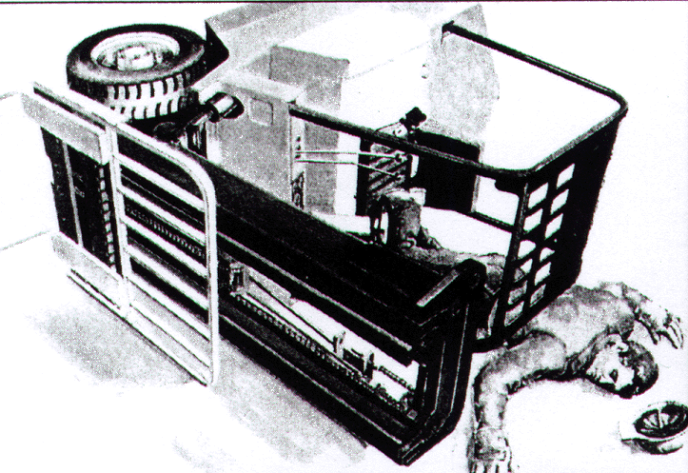
Understanding your equipment
SIDE TIP-OVERS:
  Never turn on a ramp
  Slow down for turns
  Wear your seatbelt at all times
Never try to jump out. There is not enough time for you to clear the truck.
If your truck begins to tip sideways, whatever you do, stay in the truck. Hold on tight. Brace your feet. Lean away from the direction of the tip.
Notes:
Safe Operational Procedures
Side Tip Overs are the MOST deadly of ALL Forklift accidents.
Explain how the initial human reaction to a tip over is to want to JUMP OUT of the forklift operator’s seat. But when you jump, it is more than likely than not that you will not be able to get away from the ROPS (roll over protection structure) fast enough and it will crush some part of your body.
This happens quite often and it usually results death. This is why it is extremely important to wear your seatbelt while operating this piece of equipment. The Seatbelt will keep you on the forklift seat in the event of a side tip over.
Also, go over the bottom paragraph of this slide with the trainees. It instructs them on what to do if a side tip over occurs.

Slide 57

Understanding your equipment
HAZARD AREAS:
No person shall ever stand under elevated forks or buckets at any time.
Never elevate a person, using the forks or bucket as a platform.
Notes:
Safe Operational Procedures
Explain the hazards associated with a forklift and how to avoid them.
In the 1st picture the person should NEVER be under any device held up by hydraulics UNLESS it has first been Blocked into position. It is important to know that if the hydraulic lines burst OR lose pressure than the forks will come down to the ground (hitting you in the process).
In the 2nd picture the person should never RIDE the Forks up to any height. This practice was common in the past, but now we have machines (Aerial Work Platforms) designed to raise a person to a desired height in order to get a job done. NEVER RIDE THE FORKS!!!

Slide 58
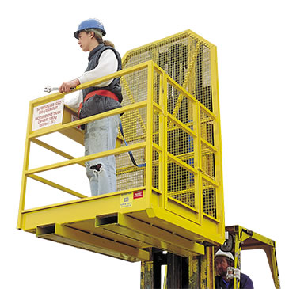
Personnel Lifting Baskets
Are they rated for lifting people?
Have personnel in the basket received education and training on this type of operation and are they wearing fall protection?
Is the basket properly attached to the mast of the lift truck?
Notes:
Discuss the need for making sure that the equipment is rated for lifting personnel and that the basket that is being used is also rated for lifting personnel. Other steps to consider with an operation like this:
Is the basket secured to the lift truck?
Are personnel in the basket using some type of fall restraint system?
Is the lift truck operator trained to do this type of operation?

Slide 59
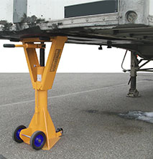
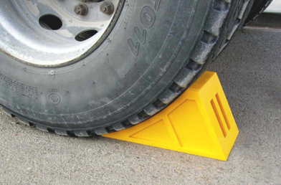
Loading/Unloading Trailers
Make sure truck brakes are set.
Make sure wheels of trailer have been chocked.
Make sure a jack stand is in place if the semi truck is not present.
Check the trailer floor, making sure it will support the weight of the lift truck and the load.
Make sure the dock board is secured, in good condition and of proper capacity.
It is the lift truck operators responsibility to ensure that the wheels are chocked.
Notes:
Safe Operational Procedures
When loading and unloading truck trailers IT IS THE RESPONSIBILITY OF THE FORKLIFT OPERATOR TO CHOCK THE TRAILER WHEELS. The truck driver is not responsible for doing this.
While you (the forklift operator) are out chocking the wheels it is also a good idea to look up under the trailer and note the condition of the trailer floorboards. There are some trailers that are in rough condition and as a forklift or skid steer operator you want to know the condition of the trailer you will be entering. Some forklifts weigh 10,000 lbs. and some loads weigh 5,000 lbs. so if you take 15,000 lbs. into a trailer with poor floor conditions you may find disaster. ALWAYS CHECK THE TRAILER FLOORING!
If jackstands are available then you should use them.
OSHA strongly recommends following both the trailer and the jack manufacturer's instructions on the appropriate number and placement of these jacks. Additional guidance on the loading and unloading of trailers with powered industrial trucks may be found on OSHA's website at http://www.osha.gov/SLTC/poweredindustrialtrucks/loading_unloading.html.
This is a good time to ask if anyone has ever had experience loading / unloading semi trailers.

Slide 60

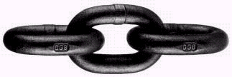
Lifting with chain
All Chain used for Lifting MUST have a tag stating Size, Grade, and Serial Number of the Chain Sling
Notes:
When lifting with chain be sure to use approved alloy steel lifting chain that is Grade 8 or higher.
Inspect the chain every time before using it

Slide 61


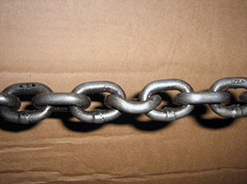
Pulling with chain
Inspect the chain before each use. Look for:
Stretched, bent, or twisted links
Nicks, gouges
Discoloration (from excessive heat)
THINK: If the chain or other pulling device were to break while being used for pulling where or who will it fly towards?
Notes:
Discuss the importance of looking closely at the links as not all of them could be damaged or worn and sometimes the damage does not stand out.
Inspect the chain every time before using it

Slide 62
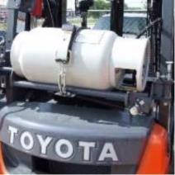
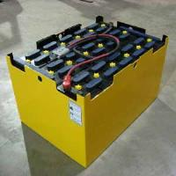
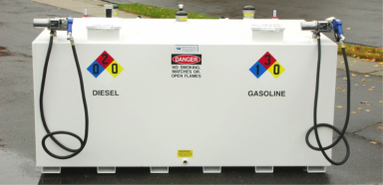
Re-fueling
What type of fuel does your equipment use?
  Gasoline, Diesel, Battery, Propane
You should be aware of the hazards associated with each type of fuel that your mobile equipment requires.
62
Notes:
What are the hazards involved with filling your own propane tanks?
Are you using gasoline or diesel for fuel, how about battery operated mobile equipment?
What is your smoking policy?
Do you know the difference between the gas and/or diesel tank?
Leaking propane will burn you if it gets on your skin because it is extremely cold.
Keep open flames away!

Slide 63
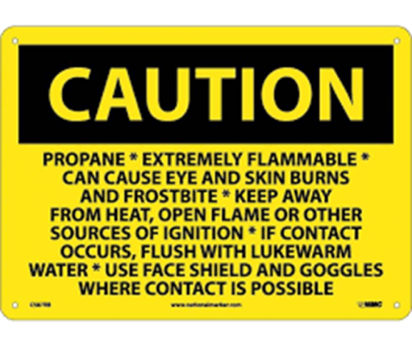
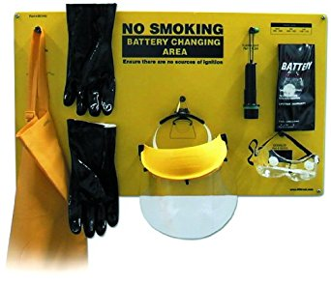
Re-fueling
PPE for handling propane and batteries.
63
Notes:
Discuss the need for using proper ppe when handling propane and/or batteries. Also discuss the need for safety around gasoline and diesel. “What is the smoking policy at your facility?”

Slide 64
Be aware of Carbon Monoxide
HUNTERSVILLE, NC (WBTV) - Three people were taken to the hospital and nine others were evaluated after officials detected high levels of carbon monoxide inside a Huntersville building Monday afternoon.
The source of the carbon monoxide was a forklift, the Huntersville Fire Department determined.
The incident happened just before 12:30 p.m. a building in the 11500 block of Vanstory Drive, where fire officials worked to ventilate the structure.
Medic took three people to Novant Huntersville with minor injuries and evaluated nine others.
By 1:40 p.m., Huntersville fire officials said the building was clear and safe.
http://www.wbtv.com/story/30586558/forklift-to-blame-for-co-detection-in-huntersville-building-hospitalizing-3
Notes:
Share story of carbon monoxide poisoning and cautions
CO monitors can help to reduce the risk associated with this hazard in your warehouse

Slide 65
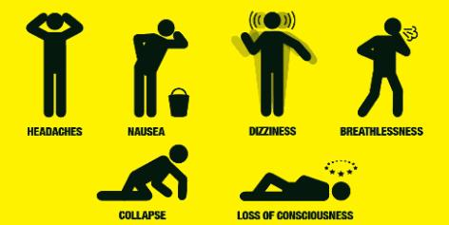
Signs & Symptoms of CO
Carbon monoxide, also known as CO, is a deadly gas. It's colorless, odorless and tasteless, making it impossible to detect by human senses. When Co is breathed in, it quickly replaces the oxygen in the bloodstream. Various stages of illness can easily lead up to unconsciousness and death.
Notes:
Share story of carbon monoxide poisoning and cautions, signs, and symptoms.
Carbon monoxide, also known as CO, is a deadly gas. It's colorless, odorless and tasteless, making it impossible to detect by human senses. When Co is breathed in, it quickly replaces the oxygen in the bloodstream. Various stages of illness can easily lead up to unconsciousness and death.
Sleepiness
Fatigue
Pain or tightness across the chest
Shortness of breath
Dizziness
Headache
Nausea
If exposure continues, you will become confused, weak, vomit, convulse and eventually collapse.

Slide 66
Cell Phone Use And Texting
What is your policy?
Notes:
What is your policy?
What are the hazards around cell phone use in the operating environment?
If cell phones are used in your operations do you have “safe areas” that you use them in?
This slide should create a lot of discussion within the class

Slide 67

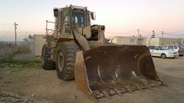
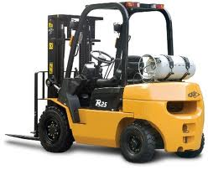
Knowing the hazards around Powered Industrial Vehicles
Summary
Operation – Trained and Certified Operator, Travels at safe speeds, Wears seatbelt at all times, people nearby the equipment
Load handling – Center of Gravity, Capacity of equipment, Clear vision
Equipment condition – Brakes, lights, horn, tires, back-up alarm, hoses, battery, fuel system
Shipping/Receiving area – Dock plate condition, Wheels chocked, Trailer condition
Notes:
Operations:
Are operators trained and certified to use the equipment?
Do operators travel at safe speeds?
Do operators wear the seat belt at all times?
Does the facility allow pedestrians to be nearby operating mobile equipment?
Load Handling:
Does the operator understand the center of gravity, dynamic, and static forces that apply to the equipment that they are operating?
Does the operator know the capacity of the equipment that they are operating?
Can the operator see clearly when they are traveling with, or moving a load with their piece of mobile equipment?
Equipment Condition:
Has the operator done a pre-operational inspection of the equipment?
Is the equipment safe to use in the facility’s operating environment?
Shipping/Receiving Area:
Is the dock plate in good condition?
Does the mobile equipment operator understand the need for communications with the truck driver?
Who chocks the truck’s wheels? Why?
What is the jack stand used for?
What is the condition of the trailer that the equipment operator will be traveling into and out of?

Slide 68

Training and Operator Certification
The employer shall certify that each operator has been trained and evaluated as required by the powered industrial truck standard.
Certification shall include:
  Name of operator
  Date of training
  Date of evaluation
  Identity of person(s) performing
  the training or evaluation
Notes:
Who can certify the operator? How does the trainer get certified?

Slide 69
Mobile equipment checklist
Operators trained to operate safely
Equipment inspections are getting done
Back-up alarms, lights, horn function properly
Data plates are legible
Three point RULE is being used when climbing on/off of machinery
Pedestrians are at a safe distance from operating machinery
Operators are wearing seatbelts
Equipment is being operated safely and within its limits
Forks lowered to the ground when machine is parked
Notes:
Reference the checklist that was already given out to each participant

Slide 70
Quiz – Mobile Equipment
When approaching mobile equipment, it is important to do which of the following?
  Walk behind the equipment and wait for the operator to stop
  Make eye contact with the operator and wait for permission to approach
  Stand in the middle of the roadway to flag down the operator
  Walk beside the operator and yell until the operator stops the equipment
Notes:
B.
Question 2 on Pre/Post Test

Slide 71
Quiz – Mobile Equipment
One way to prevent a dangerous situation when working around moving equipment would be to:
  Avoid danger zones
  Assume the equipment operator can see you
  Always walk behind mobile equipment
  Ride along with the operator
Notes:
A.

Slide 72
Quiz – Mobile Equipment
Equipment operators and pedestrians play an important role in mobile equipment safety.
True or False
Notes:
TRUE

Slide 73
Quiz – Mobile Equipment
Which of the following has the potential to cause blind spots?
  Corners of buildings
  Stacks of products or materials
  Structural supports that exist in the cab of mobile equipment
  All of the above
Notes:
D.
Question 3 on Pre/Post Test

Slide 74
Quiz – Mobile Equipment
Which of the following is a common cause of injuries when climbing up, down, on or off of mobile equipment?
  Not using proper fall protection
  Ensuring steps are in good condition before climbing up, down, on or off of the equipment
  Failure to use three points of contact when climbing up, down, on or off of the equipment
  Facing the equipment when climbing up, down, on or off of the equipment
Notes:
C.
Question 9 on Pre/Post Test

Slide 75
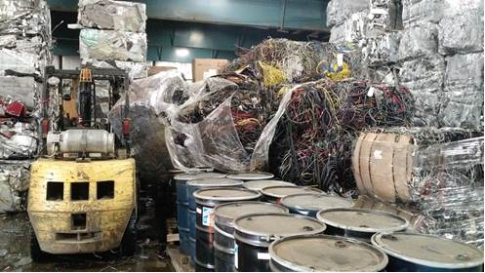
Accident Scenario
Details: Loose undersized bales of insulated wire improperly stacked with heavy bales above fell across another row and struck parked forklift.

Slide 76
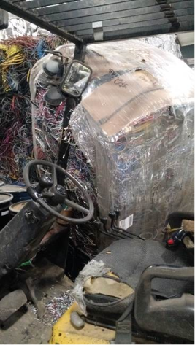
What happened
Bales came in from a customer not uniform in size.
Weather conditions allowed for snow/ice in material which later melted when inside.
Bale stack slowly settled over the next two days.
Forklift Op was parked in row next to another stopped PIT Operator discussing workload.
Stack fell into ROPS of forklift nearly missing operator.

Slide 77

Corrective Actions
Ensure lightest materials are always placed on top.
Create a Safe Materials Stacking Guidance document with employee training.
Implemented a daily safe stacking inspection requirement for all warehousing operations.

Slide 78

Corrective Actions
Identify and segregate customer materials from materials we package ourselves.
Raise awareness how weather conditions can have effects on materials coming in (Note – water on floor from melted snow/ice can affect safe operations).
Implemented a ‘Safe Zone’ for ANY foot traffic away from stacked materials.
Implemented a safety policy for PIT’s not to stop or converse in aisles of stacked materials (for multiple reasons).
Review incident and corrective actions with all.

Slide 79
How do we fix this so it doesn’t happen again?
Notes:
Everyone at the plant has to be on the same page when it comes to hazard recognition and mitigation

Slide 80


Job Procedures
Notes:
The intent with this slide is to show how detailed instructions, or a well thought out process can assist in hazard mitigation.

Slide 81

Fire Prevention and Housekeeping
Notes:
Before beginning this section show video titled Fire Prevention (14’ 11”).
12 Ways to Prevent a Workplace Fire
Preventing fires is everyone’s job. We all need to be alert to anything that could cause a fire, and take responsibility to report any problem areas so they can be corrected. Here are some reminders about fire prevention:
1. Practice good workplace housekeeping. Clutter contributes to fires by providing fuel and by preventing access to exits and emergency equipment.
2. Place oily rags in a covered metal container. This waste must be properly disposed of on a regular basis.
3. Maintain machinery to prevent overheating and friction sparks.
4. Report electrical hazards. Many fires start in faulty wiring and malfunctioning electrical equipment. Never attempt electrical repairs unless you are qualified and authorized.
5. Maintain free access to all electrical control panels. Material or equipment stored in front of the panels would slow down the shutting down of power in an emergency situation.
6. Use and store chemicals safely. Read the label and the Safety Data Sheet to determine flammability and other fire hazards. Provide adequate ventilation when using and storing these substances.
7. Use all precautions to prevent ignition in potentially explosive atmospheres such as those containing flammable liquid vapors or fine particles. Use non-sparking tools, and control static electricity as required.
8. Help maintain building security to prevent arson fires. Lock up as instructed; report suspicious persons; and don’t leave combustible rubbish where it can be set afire outside the building.
9. Smoke only in designated areas, and extinguish smoking materials safely. Never smoke in storerooms or chemical storage areas.
10. Never block sprinklers, firefighting equipment or emergency exits. Observe clearances when stacking materials.
11. Post emergency telephone numbers as well as the company address by the telephone in your station for quick access if a fire were to start in your work area.
12. Learn how to properly use a fire extinguisher.

Slide 82
Good Housekeeping
Identify the possible fire hazards in your workplace
Notes:
Flammable and/or combustible material storage
Clothing requirements (especially for those individuals doing hot work)
Poor electrical conditions
Hot work that does not include an area inspection before the job is started – consider using a hot work permit
Hot work that does not include a fire watch during and after the job
Smoking policies at your workplace
Access/Egress routes and housekeeping in these areas
Fire extinguishers are in place and charged
Combustible dust

Slide 83



Class A fire
"Class A fire" means a fire involving ordinary combustible materials such as paper, wood, cloth, and some rubber and plastic materials
Notes:
Know the different classes of fires and where these hazard types might be in your facility.
http://www.ilpi.com/safety/extinguishers.html
http://www.bettendorf.org/egov/docs/1160167747_549163.pdf

Slide 84

Class B fire
"Class B fire" means a fire involving flammable or combustible liquids, flammable gases, greases and similar materials, and some rubber and plastic materials
A Flammable Liquid is one that has a flashpoint below 100 degrees F. While a Combustible Liquid is one that has a flashpoint above 100 degrees F.
Notes:
Know the different classes of fires and where these hazard types might be in your facility.
http://www.ilpi.com/safety/extinguishers.html
http://www.bettendorf.org/egov/docs/1160167747_549163.pdf

Slide 85

Class C fire
"Class C fire" means a fire involving energized electrical equipment where safety to the employee requires the use of electrically nonconductive extinguishing media
Notes:
Know the different classes of fires and where these hazard types might be in your facility.
http://www.ilpi.com/safety/extinguishers.html
http://www.bettendorf.org/egov/docs/1160167747_549163.pdf

Slide 86

Class D fire
"Class D fire" means a fire involving combustible metals such as magnesium, titanium, zirconium, sodium, lithium and potassium
Notes:
Know the different classes of fires and where these hazard types might be in your facility.
http://www.ilpi.com/safety/extinguishers.html
http://www.bettendorf.org/egov/docs/1160167747_549163.pdf

Slide 87
Incipient stage fire
"Incipient stage fire" means a fire which is in the initial or beginning stage and which can be controlled or extinguished by portable fire extinguishers, or small hose systems without the need for protective clothing or breathing apparatus
Notes:
Only those individuals who are trained and educated to do so should fight a fire which is beyond the incipient stage.
The FOUR STAGES of a FIRE
By most standards including the International Fire Service Training Association (IFSTA) there are 4 stages of a fire. These stages are incipient, growth, fully developed, and decay. The following is a brief overview of each stage.
Incipient – This first stage begins when heat, oxygen and a fuel source combine and have a chemical reaction resulting in fire. This is also known as “ignition” and is usually represented by a very small fire which often (and hopefully) goes out on its own, before the following stages are reached. Recognizing a fire in this stage provides your best chance at suppression or escape.
Growth – The growth stage is where the structures fire load and oxygen are used as fuel for the fire. There are numerous factors affecting the growth stage including where the fire started, what combustibles are near it, ceiling height and the potential for “thermal layering”. It is during this shortest of the 4 stages when a deadly “flashover” can occur; potentially trapping, injuring or killing firefighters.
Fully Developed – When the growth stage has reached its max and all combustible materials have been ignited, a fire is considered fully developed. This is the hottest phase of a fire and the most dangerous for anybody trapped within.
Decay – Usually the longest stage of a fire, the decay stage is characterized a significant decrease in oxygen or fuel, putting an end to the fire. Two common dangers during this stage are first – the existence of non-flaming combustibles, which can potentially start a new fire if not fully extinguished. Second, there is the danger of a backdraft when oxygen is reintroduced to a volatile, confined space.

Slide 88
Fire extinguishers
Portable fire extinguishers should be mounted and located so that they are readily accessible to employees without subjecting them to possible injury
Notes:
Practice good housekeeping to keep fire fighting equipment readily accesable

Slide 89

Fire extinguishers
Be sure that portable fire extinguishers are maintained in a fully charged and operable condition and kept in their designated places at all times except during use

Slide 90

Fire extinguishers
P – Pull the pin
A – Aim the nozzle toward the base of the fire
S – Squeeze the handle
S – Sweep the nozzle back and forth at the base of the fire
Notes:
Share the F.Y.S. handout with the group and discuss the meaning of PASS and also what an incipient stage fire is.

Slide 91
Fire prevention checklist
Fire extinguisher(s) accessible and their location’s are marked properly
Fire extinguishers are in place and charged
No combustibles or flammables in hot work areas
Trash/Rag cans covered or emptied on a daily basis
Clear egress routes and exit signs
Automatic sprinkler heads unobstructed
Flammable liquids stored properly
Combustible materials kept to a minimum in process areas
Fire extinguisher are checked per code
Notes:
Fire extinguisher(s) accessible and their location’s are marked properly
Fire extinguishers are in place and charged
No combustibles or flammables in hot work areas
Trash/Rag cans covered or emptied on a daily basis
Clear egress routes and exit signs
Automatic sprinkler heads unobstructed
Flammable liquids stored properly
Combustible materials kept to a minimum in process areas
Fire extinguisher are checked per code

Slide 92
Housekeeping checklist
Aisles/Stairs/Work stations clear of obstructions (slip/trip hazards)
Entry/Exits clear and unlocked
Work area clear of recognized hazards
Disconnects accessible
Compressed cylinders stored properly
Material stacked properly (will it fall)
Break room clean
Overall general area clean
Proper spill management tools available and used
Scrap stored properly/orderly
Mobile equipment cabs
Condition of maintenance shop areas
Restrooms clean and sanitary
Notes:
Aisles/Stairs/Work stations clear of obstructions (slip/trip hazards)
Entry/Exits clear and unlocked
Work area clear of recognized hazards
Disconnects accessible
Compressed cylinders stored properly
Material stacked properly (will it fall)
Break room clean
Overall general area clean
Proper spill management tools available and used
Scrap stored properly/orderly
Mobile equipment cabs
Condition of maintenance shop areas
Restrooms clean and sanitary

Slide 93
Quiz – Fire Prevention
Fire watches are responsible for which of the following?
  Continually watching for fires
  Knowing how to alert employees in the event of a fire
  Having a fire extinguisher and know how to operate it
  All of the above
Notes:
D.
Question 7 on Pre/Post Test

Slide 94
Quiz – Fire Prevention
How far away must combustible materials be removed from an area where hot work is being performed?
  15 feet
  25 feet
  35 feet
  45 feet
Notes:
C.
Question 15 on Pre/Post Test

Slide 95
Quiz – Fire Prevention
Identifying and eliminating fire hazards is the key to fire prevention.
True or False
Notes:
TRUE
Question 1 on Pre/Post Test

Slide 96
Quiz – Fire Prevention
Before you begin any type of hot work activities, you should first evaluate your work area to identify items that have the potential to ignite.
True or False
Notes:
TRUE
Question 6 on Pre/Post Test

Slide 97
Quiz – Fire Prevention
What is the proper way to operate a fire extinguisher?
  Pull, Aim, Twist, and Shout
  Pull, Aim, Squeeze, and Sweep
  Point, Aim, and Side-to-Side
  Pull the pin and squeeze the handle
Notes:
B.

Slide 98

Lockout/Tagout
Notes:
Before beginning this section show video titled Lockout Tagout (16’ 46”).

Slide 99

When is Lock Out Tag Out Required?
Servicing, maintaining, or un-jamming equipment where:
  Hazardous energy exists
  When a start-up could occur
  Either of these could injure a worker
Notes:
If you are unsure to what equipment LOTO applies, perform a hazard analysis.
Make sure that all sources of energy are considered.
Do not jeopardize an employee by not requiring LOTO
When in doubt, lock it out

Slide 100
Use Lock Out Tag Out when:
Employees are required to remove or bypass a safety device.
Employees are required to place any part of their body in harm’s way.
Employees are exposed to hazardous energy.
Notes:
Anytime an employee could be injured by the piece of equipment, it should be de-energized and locked out.
A safety device in this case can be a guard.

Slide 101
Energy Sources
Mechanical
Thermal
Hydraulic
Pneumatic
Magnetic
Gravity
Electrical
Gas
Water
Other stored energy
  (i.e. springs, capacitors)
Notes:
There are many different types of energy sources that may need lockout/tagout. Do not overlook any potential source of energy.
Many sources are invisible.
A job hazard analysis can help identify energy sources.
Make sure any and all sources of energy can be effectively isolated.

Slide 102

Remember
Lockout is not just for when things go wrong.
Lockout is not just for maintenance workers.
Make everyone understand AND uses it.

Slide 103

What do we Lockout?
Notes:
List the types of equipment we have to lockout.
Ask those in the room. What do they have at their facilities that might need LOTO.
There are 3 lockout points on this system, the main electrical point, the conveyor, and the wire tyer system.

Slide 104

Machinery with Multiple LOTO Points
Notes:
Ask those in the room…
What type of machinery do you have that might have multiple LOTO points at your facility?

Slide 105

What about this?
Notes:
Is this a LOTO issue? How do you do it?

Slide 106
A 47-year-old man was operating a forklift in the bed of a semi-trailer. As the truck driver was pulling away from the dock, the forklift fell from the trailer bed to the ground...The forklift operator was able to get himself off the ground and enter the facility, where he was treated by medical personnel. Approximately 16 hours later he died as a result of the injuries he suffered.
Notes:
ASK this question to the group: Is it the responsibility of the person going in and out of the trailer to chock the wheels of the trailer? If you let a truck driver do this for you it is still your responsibility to check the chocks to be sure that they are in place.

Slide 107

Always Chock Your Wheels
Notes:
OSHA Letters of Interpretation on this subject
https://www.osha.gov/pls/oshaweb/owadisp.show_document?p_table=INTERPRETATIONS&p_id=28121
https://www.osha.gov/pls/oshaweb/owadisp.show_document?p_table=INTERPRETATIONS&p_id=25161

Slide 108


Glad Hand Locks
Notes:
Discuss the use of glad hand locks and how they are used to lock out the air lines to the braking system of the trailer. This is a positive locking system that make the trailer wheels unable to roll.
Air Brake Glad Hand Locks Help Prevent Unscheduled Departures from your Dock Bay. Glad hand locks are the perfect device to "dead-line" a trailer, offering a simple way to prevent a trailer from being moved while being loaded or unloaded.
Short YouTube Video on this subject -- https://www.youtube.com/watch?v=OuFV8CBzp48

Slide 109

Make it Foolproof
Notes:
A device like this may be set in place to ensure that the driver does not leave until the Stop sign is removed from in front of their tractor.

Slide 110

Authorized Employee
Maintains and/or uses the equipment
Services equipment
Is properly and thoroughly trained to use lockout/tagout procedures
Operates equipment (sometimes)
Notes:
Authorized employees are these who are at risk while the equipment is being repaired or adjusted.
It is important that authorized employees inform affected employees of the work to be done.
The “danger tag” is an important communication device for the authorized employee.
Authorized employees are the only ones who can place a LOTO device on the equipment.

Slide 111
Affected Employees
Employees who:
Operate
Work around
Occasionally adjust equipment that is subject to lockout tagout
Notes:
Affected employees can be almost anyone in a facility.
An affected employee can have a significant impact on authorized employees if the affected employee starts the equipment prior to the completion of the work by the authorized employee.
Remember to discuss the “Other Employee” category of people under this standard.

Slide 112
Where to Begin
First, conduct a HAZARD ASSESSMENT by identifying each piece of equipment that is used, serviced, or maintained
  Include broken or stored equipment
Then, determine the requirements for lockout
  If there is more than one primary energy source to the equipment, document each source
Notes:
This is part of your overall written program. Identify each piece of equipment.

Slide 113
Where to Begin
Document all energy sources
  Hidden
  Direct
The hazard posed
The magnitude or measurable degree of danger
Special or unusual conditions
Proper isolations and devices
Notes:
Document all energy sources
Hidden
Direct
The hazard posed
The magnitude or measurable degree of danger – Lock it out!
Special or unusual conditions – Lock it out!
Proper isolations and devices

Slide 114

Types of Lockout Devices
Locks
Blocks
Chains
Multilock hasps
Wheel valve covers
Ball valve covers
Gladhand locks
Notes:
Any type of lockout/tagout device that is used must be durable.
There are no requirements for the specific type of device as long as it can be locked.
It is a good idea to have a variety of devices available to fit all situations.
Tags should always accompany the use of any of these devices.
A tag is not a device, because it does not prevent the start-up of the equipment.

Slide 115


Overhead Crane Controls/Plugs

Slide 116

Breakers

Slide 117

Wall Switches

Slide 118


Options for mobile equipment
Notes:
This can be purchased from your mobile equipment dealer…

Slide 119

Requirements for LOTO Devices
Durable
Standardized
Substantial
Identifiable
Notes:
LOTO devices must be able to withstand the environment in which they are used.
They should also be standardized according to color, size, or shape and should be substantial enough so that they cannot be accidentally removed.
To be identifiable, they should have a legend that states phrases such as Do Not Operate, Do Not Start, Do Not Energize, etc.

Slide 120


Remember
One Person
One Lock
One Key

Slide 121

Use a Tag
Name & Phone Number
YOUR NAME
321-555-1212
Notes:
A picture eliminates language barriers.
The phone number allows for immediate contact of authorized employee in his absence.

Slide 122

Always Lock it Out!
Notes:
Lock it Tag out Try out!!!

Slide 123




Label your Lockout Points

Slide 124
Lock Out Tag Out Checklist
Annual authorized person training complete
Annual affected person training complete
Disconnects labeled and accessible
Authorized employees have access to locks
All hazards are locked out
Employees maintain key during LOTO
Try (verify) out is done after LOTO is applied
Locks and tags used to identify user
LOTO devices are in good working order
Written procedures accessible to all
Periodic (annual) inspections are getting done

Slide 125
Quiz – Lock Out Tag Out
What is the purpose of a group lockout?
  To lockout multiple energy isolating devices
  To ensure that each employee performing the servicing or maintenance is provided the same level of protection
  To identify energy isolating devices
  To communicate the lockout/tagout/tryout procedure
Notes:
B.
Question 5 on Pre/Post Test

Slide 126
Quiz – Lock Out Tag Out
Which of the following is important and must take place at the beginning and at the end of every lockout/tagout/tryout situation?
  Lock removal
  Communication with all employees in the area
  Lock placement
  Lockout procedure review
Notes:
B.
Question 12 on Pre/Post Test

Slide 127
Quiz – Lock Out Tag Out
Equipment must be locked out when servicing or doing maintenance work, when the point of operation is accessed, or when a guard is removed or bypassed.
True or False
Notes:
TRUE
Question 10 on Pre/Post Test

Slide 128
Quiz – Lock Out Tag Out
An energy control procedure is unique to each piece of equipment and is a step-by-step guide for how-to lock out a piece of equipment that is being worked on.
True or False
Notes:
TRUE
Question 11 on the Pre/Post Test

Slide 129
Quiz – Lock Out Tag Out
Is it ok to un-jam a baler without locking it out?
True or False
Notes:
FALSE

Slide 130

HAZARD COMMUNICATION
Notes:
Before beginning this section show video titled Working Safely with Chemicals (19’ 43”).

Slide 131

  HAZCOM Standard
  Hazard Classification
  SDSs
  Labels
  Pictograms
  HAZCOM Program
Notes:
Things we are going to talk about in this presentation.

Slide 132

The HazCom Standard
Gives you the right to know about:
  Chemicals that are used in your workplace
  Possible dangers you could be exposed to
  How to protect yourself and others
Notes:
The Occupational Safety and Health Administration, or OSHA, developed the Hazard Communication Standard to help protect employees from the dangers of hazardous chemicals. Commonly known as HazCom, or the “Right to Know” law, this regulation gives you the right to know which chemicals are being used in your workplace, the possible dangers you could be exposed to, and how to protect yourself and others when using hazardous chemicals.
Why is the HAZCOM standard is important ?‘’ Hazcom standards help workers: • Reduce their risks to chemicals • Avoid dangerous chemicals • Obtain proper education about chemicals • Select proper PPE ‘’

Slide 133
How it Works
  Employers who do not produce chemicals should focus on:
    Identify and list hazardous chemicals in workplaces.
    SDS & Labeling: Obtain Safety Data Sheets and labels for each hazardous chemical, if not provided by the manufacturer, importer, or distributor.
    Implement a written HazCom program, including labels, SDS, and employee training.
    Communicate hazard information to employees through labels, SDSs, and formal training programs.

Slide 134
Hazardous Chemical
Any chemical which is classified as:
  Physical Hazard
  Health Hazard
  A simple asphyxiant
  Combustible dust
  Pyrophoric gas
  Hazard not otherwise classified

Slide 135

Physical Hazard
Physical hazards are chemicals that can cause
  Fire
  Explosion
  Violent reaction
Notes:
OSHA Website:
Physical hazard means a chemical that is classified as posing one of the following hazardous effects: explosive; flammable (gases, aerosols, liquids, or solids); oxidizer (liquid, solid or gas); self-reactive; pyrophoric (liquid or solid); self-heating; organic peroxide; corrosive to metal; gas under pressure; or in contact with water emits flammable gas.

Slide 136

Health Hazard
Health hazards are chemicals that are harmful to your health and can cause:
  Short-term (acute)
  health problems
  Long-term (chronic)
  health problems
Notes:
Short-term (acute)
• High exposure over a short time (instantaneous to a few days)
• After exposure stops, damage may reverse…or not
Long-term (chronic)
Low exposure over a long time period (years)
• Can cause disease or other irreversible effects

Slide 137
Health Hazard
OSHA considers a health hazard to be any chemical which:
  Is toxic
  Is corrosive to the skin or eyes
  Is a respiratory sensitizer
  May cause cancer, birth defects or reproductive issues
  Attacks specific organs
  Is harmful or deadly when inhaled

Slide 138

A Simple Asphyxiant
A substance or mixture that displaces oxygen in the ambient atmosphere, and can thus cause oxygen deprivation in those who are exposed, leading to unconsciousness and death.
Notes:
If a chemical replaces so much air that there isn’t enough oxygen to breathe it can cause simple asphyxiation.
A SIMPLE ASPHYXIANT does not allow oxygen to be transferred to the cells. Examples are: Carbon dioxide, hydrogen, methane, and nitrogen. A CHEMICAL ASPHYXIANT prevents the uptake of oxygen by the cells. Example: Carbon Monoxide - prevents oxygen transport by combining with hemoglobin developing carboxy hemoglobin.

Slide 139
Combustible Dust
Any combustible material can burn rapidly when in a finely divided form.
If such a dust is suspended in air in the right concentration, under certain conditions, it can become explosible.
Materials that do not burn in larger pieces (such as aluminum or iron), given the proper conditions, can be explosible in dust form.
Notes:
The force from such an explosion can cause employee deaths, injuries, and destruction of entire buildings.
Explosible meaning : Capable of being exploded.

Slide 140

Pyrophoric Gas
A chemical in a gaseous state that will ignite spontaneously in air at a temperature of 130 degrees F (54.4 degrees C) or below.
Notes:
Examples are iron sulfide and many reactive metals including plutonium and uranium, when powdered or thinly sliced. Pyrophoric materials are often water-reactive as well and will ignite when they contact water or humid air. They can be handled safely in atmospheres of argon or (with a few exceptions) nitrogen. Pyrophoric materials are often water-reactive as well and will ignite when they contact water or humid air. Most pyrophoric fires should be extinguished with a Class D fire extinguisher for burning metals.
The creation of sparks from metals is based on the pyrophoricity of small metal particles, and pyrophoric alloys are made for this purpose.^{[2]} This has certain uses: the sparking mechanisms in lighters and various toys, using ferrocerium; starting fires without matches, using a firesteel; the flintlock mechanism in firearms; and spark-testing ferrous metals.
Solids
White phosphorus, the original "phosphor"
Alkali metals (lithium, sodium, potassium, rubidium, caesium), including the alloy NaK
Finely divided metals (iron,^{[3]} aluminium,^{[3]} magnesium,^{[3]} calcium, zirconium, uranium, titanium, bismuth, hafnium, thorium, osmium, neodymium)
Some metals and alloys in bulk form (cerium, plutonium)
Alkylated metal alkoxides or nonmetal halides (diethylethoxyaluminium, dichloro(methyl)silane)
Potassium graphite (KC₈)
Metal hydrides (sodium hydride, lithium aluminium hydride, uranium trihydride)
Methane tellurol (CH₃TeH), an analog of methanol where tellurium replaces oxygen
Partially or fully alkylated derivatives of metal and nonmetal hydrides (diethylaluminium hydride, trimethylaluminium, triethylaluminium, butyllithium), with a few exceptions (i.e. dimethylmercury and tetraethyllead)
Copper fuel cell catalysts, e.g., Cu/ZnO/Al₂O₃^{[4]}
Grignard reagents (compounds of the form RMgX)
Used hydrogenation catalysts such as palladium on carbon or Raney nickel (especially hazardous because of the adsorbed hydrogen)
Iron sulfide: often encountered in oil and gas facilities where corrosion products in steel plant equipment can ignite if exposed to air.
Lead and carbon powders produced from decomposition of lead citrate^{[5][6]}
Uranium is pyrophoric, as shown in the disintegration of depleted uranium penetrator rounds into burning dust upon impact with their targets. In finely divided form it is readily ignitable, and uranium scrap from machining operations is subject to spontaneous ignition.^{[7]} The GBU-39 is an example of a "bunker buster" bomb where uranium is mentioned in the patent as a way to achieve an "incendiary effect" with "pyrophoricity".^{[8]}
Neptunium
Plutonium: several compounds are pyrophoric, and it causes some of the most serious fires occurring in United States Department of Energy facilities.^{[9]}
Petroleum hydrocarbon (PHC) sludge.
Liquids
Diphosphane
Metalorganics of main group metals (e.g. aluminium, gallium, indium, zinc and cadmium etc.)
Triethylborane
tert-Butyllithium
Diethylzinc
Triethylaluminium
Hydrazine is hypergolic with oxidants like dinitrogen tetroxide, but not truly pyrophoric.
Gases
Nonmetal hydrides (arsine, phosphine, diborane, germane, silane)
Metal carbonyls (dicobalt octacarbonyl, nickel carbonyl)

Slide 141

2012 Changes
MDSDs are now SDSs
16 Sections
Always in the same order

Slide 142
Safety Data Sheets
Section 1: Identification
Section 2: Hazard(s) identification
Section 3: Composition/information on ingredients
Section 4: First-aid measures
Section 5: Fire-fighting measures
Section 6: Accidental release measures
Section 7: Handling and storage
Section 8: Exposure controls/personal protection
Section 9: Physical and chemical properties
Section 10: Stability and reactivity
Section 11: Toxicological information
Section 12: Ecological information*
Section 13: Disposal considerations*
Section 14: Transport information*
Section 15: Regulatory information*
Section 16: Other information
Notes:
Its good to hand out an example of Safety Data sheet to everyone in the class!
The items in red have the primary safety information for employees.

Slide 143
Safety Data Sheets
Section 2: Hazard(s) Identification
The required information consists of:
  The hazard classification of the chemical (e.g., flammable liquid, category1).
  Signal word.
  Hazard statement(s).
  Pictograms (the pictograms or hazard symbols may be presented as graphical reproductions of the symbols in black and white or be a description of the name of the symbol (e.g., skull and crossbones, flame).
  Precautionary statement(s).
  Description of any hazards not otherwise classified.
  For a mixture that contains an ingredient(s) with unknown toxicity, a statement describing how much (percentage) of the mixture consists of ingredient(s) with unknown acute toxicity. Please note that this is a total percentage of the mixture and not tied to the individual ingredient(s).

Slide 144
Safety Data Sheets
Section 4: First-aid Measures
This section describes the initial care that should be given by untrained responders to an individual who has been exposed to the chemical. The required information consists of:
  Necessary first-aid instructions by relevant routes of exposure (inhalation, skin and eye contact, and ingestion).
  Description of the most important symptoms or effects, and any symptoms that are acute or delayed.
  Recommendations for immediate medical care and special treatment needed, when necessary.

Slide 145
Safety Data Sheets
Section 5: Fire-fighting measures
This section provides recommendations for fighting a fire caused by the chemical. The required information consists of:
  Recommendations of suitable extinguishing equipment, and information about extinguishing equipment that is not appropriate for a particular situation.
  Advice on specific hazards that develop from the chemical during the fire, such as any hazardous combustion products created when the chemical burns.
  Recommendations on special protective equipment or precautions for firefighters.

Slide 146

Labels
Containers of hazardous chemicals entering workplace must be labeled with:
  Identity of chemical
  Appropriate hazard warnings
    Message, picture or symbol
    Hazards of chemical
    Target organs affected
    Legible in English, may have other languages
  Name and address of responsible party

Slide 147

Labeling
Notes:
The safety data sheet is not the only source of information. Each hazardous chemical must be labeled with the chemical name and other vital quick-reference information. The label is not intended to be the sole source of safety and hazard information, but rather serves as an immediate warning to the user.
The HazCom Standard requires that there be six label elements:
- Product identifier or ingredient disclosure;
- Signal word;
- Hazard statement;
- Pictograms;
- Precautionary statement; and
- Supplier identification.
Of these six elements, 4 are “harmonized” in the GHS system based upon the chemical’s hazard class and category – the signal word, hazard statement(s), pictogram, and precautionary statement(s).
The information on the label must be linked back to the safety data sheet and chemical inventory.
Trainer Tip: Pass out samples of a GHS-style label for a chemical that is commonly used at your company, and go over each label element in detail.

Slide 148
Labeling Exemptions
Other federal agencies control labeling requirements for the following substances:
  Pesticides
  Foods or food additives
  Distilled spirits, tobacco
  Consumer products, lumber, cosmetics
  Hazardous wastes
Notes:
When do the rules for OSHA not apply

Slide 149

Container Labeling Exemptions
No new labels necessary if existing labels convey required information
Labeling not required for portable containers if:
  Transferred from labeled containers and
  Intended for immediate use by employee performing transfer
Notes:
Some other exemptions

Slide 150

Re-Labeling
You must re-label when:
  Your employer chooses to use an OSHA-approved label in your workplace.
  A large quantity of a
  chemical is broken
  down into smaller
  ones to use in
  different areas.
Notes:
Your employer can choose to re-label chemicals in your workplace with an OSHA-approved label.
Re-labeling might occur when a large quantity of a chemical is broken down into smaller ones, and then distributed to different areas in the company.

Slide 151

Re-Labeling
If you ever find a container with no label, or an illegible label, contact your supervisor.
Never use a chemical from an unlabeled container.
Notes:
If you ever find a container without a label, or the label is illegible, contact your supervisor immediately so that a new label can be applied. Whatever you do, don’t use a chemical from an unlabeled container, or a container with an unreadable label!

Slide 152

2012 Changes
Another change in 2012 with SDS was use of pictograms.
Pictograms are used on SDSs and labels.

Slide 153

Pictograms
Health Hazard
Carcinogen
Mutagenicity
Reproductive Toxicity
Respiratory Sensitizer
Target Organ Toxicity
Aspiration Toxicity

Slide 154

Pictograms
Exclamation Mark
Irritant (skin and eye)
Skin Sensitizer
Acute Toxicity
Narcotic Effects
Respiratory Tract Irritant
Hazardous to Ozone Layer (Non-Mandatory)

Slide 155

Pictograms
Skull & Crossbones
Acute toxicity (fatal or toxic)
Notes:
Some of the pictograms included in the final rule are already widely recognized by a general audience.

Slide 156

Pictograms
Gas Cylinder
Gases Under Pressure

Slide 157

Pictograms
Corrosion
Skin Corrosion/Burns
Eye Damage
Corrosive to Metals

Slide 158

Pictograms
Exploding Bomb
Explosives
Self-Reactive
Organic Peroxides

Slide 159

Pictograms
Flame
Flammables
Pyrophoric
Self-Heating
Emits Flammable Gas
Self-Reactive
Organic Peroxides

Slide 160
HAZCOM Program
HAZCOM program must have all of these parts.
HAZCOM
Written Program
Labels
SDS’s
Training
Chemical Inventory
Notes:
HAZCOM is more than just labels

Slide 161

HAZCOM Written Program
Employer must have a written hazard communication program.
The plan does not have to be lengthy or complicated.
It must be available upon request to:
  Employees and/or their designated representative
  OSHA

Slide 162
HAZCOM Witten Program
Employees must be provided information and training on hazardous chemicals in their work area:
  At the time of their initial assignment.
  Whenever a new physical or health hazard is introduced into their work area.
  May cover categories of hazards or individual chemicals.

Slide 163
Requirements
Employees must receive training on:
  HazCom Standard requirements
  Hazardous chemical locations
  Safety data sheets
  Labels
  Protection (Protective measures such as work practices and the use of PPE)
  Detection (Using monitoring devices, observation, or smell)
  Location and availability of the written hazard communication program.

Slide 164

HAZCOM Written Program
Must contain how the following will be met:
  Labels and other forms of warning
  Safety data sheets
  Information and training
  List of chemicals

Slide 165
Employer Responsibility
  Compile a complete list of the potentially hazardous chemicals in the workplace.
  Determine if you have received safety data sheets for all of them.
  If any are missing, contact your supplier and request one.
  Do not allow employees to use any chemicals for which you have not received an SDS.

Slide 166
Employee Responsibilities
  Know where the SDSs are kept for the chemicals you are exposed to.
  Know the potential hazards you face when you use or misuse a chemical.
  Know the appropriate personal protective equipment (PPE) to where when using the chemicals in your work area.
  Understand the emergency procedures to follow in the event of a spill.

Slide 167

Hazard Communication checklist
Everyone knows what an SDS is and where they are located
Chemical inventory is completed and done
Portable containers are marked properly
Tanks and containers are properly identified
All have been trained and educated on the hazard communication program

Slide 168
Quiz – Hazard Communication
What is the purpose of the pictograms found on the Safety Data Sheets and chemical container labels?
  To provide a molecular diagram of the chemical
  To help employees quickly identify the chemical’s hazards
  To confuse people
  To provide visual instructions for what to do in an emergency
Notes:
B.
Question 13 on Pre/Post Test

Slide 169
Quiz – Hazard Communication
Safety Data Sheets are defined as a source of detailed information on health hazards of chemicals.
True or False
Notes:
TRUE

Slide 170
Quiz – Hazard Communication
How can you protect yourself against chemical hazards?
  Substituting a hazardous chemical for a less hazardous chemical
  Wearing the appropriate PPE
  Wash your hands before and after eating
  All of the above
Notes:
D.

Slide 171
Quiz – Hazard Communication
What is the purpose of a Hazard Communication Program?
  To make information about chemicals and their hazards readily available
  To serve as a company’s chemical inventory
  To provide detailed information on hazardous chemicals
  To provide emergency response information to combat a chemical incident
Notes:
A.
Question 8 on Pre/Post Test

Slide 172
Quiz – Hazard Communication
Which of the following is the quickest way for you to obtain information about a chemical?
  Call the manufacturer
  Look at the Safety Data Sheet
  Talk to your Supervisor
  Read the label
Notes:
D.

Slide 173



Personal Protective Equipment

Slide 174
Personal Protective Equipment
Hard Hat
Offers protection from falling material, sparks, or other objects that may harm the skull
  Could have a face shield attached to the hard hat
  Could have ear muffs for hearing protection attached to hard hat

Slide 175



Prescription Eye Protection
Safety Glasses
Offers protection for the eyes
  ANSI Z87 will be stamped somewhere on the frame.
  Must have side shields.
  Prescription inserts are options for those who wear glasses to see better.

Slide 176

Eye and face protection
Face shields:
  Provides full-face protection
Wear when:
  Torching
  Grinding
# 5 Tint - Torching
Clear - Grinding

Slide 177


Eyewash Stations
Eyewash stations are required if certain eye hazards are present
  batteries
  corrosive chemicals
  Acid
Where are your eyewash stations?

Slide 178


Types of foot protection
Protective Footwear
Protects feet and toes from punctures, heat, sparks, heavy objects
Spats and/or metatarsal guards will add further protection to boots, feet and legs

Slide 179

Types of hand protection
Hand / Arm Protection
  Kevlar Arm Covers
    burn/fire resistant
    cut resistant
  Kevlar Glove Inserts
    burn/fire resistant
    cut resistant
  Leather Gloves
    puncture resistance
    welding/torching
    burn/fire resistance
  PPE must be sufficient enough to protect from recognized hazards

Slide 180

Hearing Protection

Slide 181

Hearing Protection
What do you use as Personal Protective Equipment in noisy areas of your plant?

Slide 182

Hearing Protection
Can you recover from hearing loss?
https://en.wikipedia.org/wiki/Auditory_system
Notes:
The answer is NO. So this is a great point to remind those in the class to always wear hearing protection.

Slide 183

Hearing Protection
Make sure your hands are clean
Roll and condense ear plug
Gently pull your ear up and back
Insert ear plug well into the ear canal
Make sure that ear plug is a comfortable fit and is correctly inserted into the ear canal

Slide 184


Respirators
Do you need to use one?
Why do you need to use one?
What type do you use at your facility?
Is the use voluntary or mandatory?
Have you been trained to properly wear and care for the respirator?
Have you been fit tested and medically cleared?
Notes:
Questions to ask:
Do you need to use one?
Why do you need to use one?
What type do you use at your facility?
Is the use voluntary or mandatory?
Have you been trained to properly wear and care for the respirator?
Have you been fit tested and medically cleared?

Slide 185

Cleaning, Storage and Maintenance
Respirators
  Clean every time prior to use.
  Use soap and water or other Original Equipment Manufacturer’s (OEM) recommendations to clean the respirator.
  Store in a cool dry place.
  If it does not seal correctly change it out for a new one.
  The wearer must be clean shaven so the mask will seal and work properly.
Notes:
Cleaning, Storage and Maintenance
Clean every time prior to use.
Use soap and water or other Original Equipment Manufacturer (OEM) recommendations to clean the respirator.
Store in a cool dry place.
If it does not seal correctly change it out for a new one.
The wearer must be clean shaven so the mask will seal and work properly.

Slide 186
PPE checklist
PPE job hazard assessments are completed
Safety glasses with sideshields
Steel toe boots
Hard hat
Hearing protection
Cotton clothing (when necessary)
Reflective apparel
Noise exposure documented
Eyewash stations (if needed) are set up and properly maintained
PPE is being used properly, is in good condition, and stored properly
PPE is available and employees are trained to use it properly

Slide 187


PPE Hazard Assessment
Notes:
This task can and should take 45-60 minutes to complete. Make sure that enough time is given to complete it properly.
Explain to group and break them into sub-groups – 15 mins
Group works on subject assigned – 15-20 mins
Group(s) explain to class their Assessment – 20 mins
For further information see: https://www.osha.gov/SLTC/etools/shipyard/standard/ppe/hazard_assessment.html

Slide 188
Developing a PPE Hazard Assessment
STEP ONE
Inform affected employees of the process and involve them in this process. Discuss the reasons that this is being done. Review all job procedures for the area, the potential hazards of the job, and the PPE that is currently being used at this job.
STEP TWO
Review data such as reports of work-related injuries or illnesses, near-miss events and reported safety concerns. These are all sources of data that can provide helpful information for assessing hazards in the work area.
STEP THREE
Conduct a walk-through survey to identify the sources of hazards to the employees in the work area. Observe the following:
  Layout of the workplace
  Location of the employees
  Work operations
  Hazards and places where PPE is currently used including the device and reason for use
Consideration should be given to the following basic hazard categories:
Impact (flying/falling objects)
Penetration (sharp objects piercing body)
Compression (roll-over or pinching objects)
Chemical exposure (inhalation, ingestion, skin contact, eye contact or injection)
Notes:
For further information see: https://www.osha.gov/SLTC/etools/shipyard/standard/ppe/hazard_assessment.html
Based on the hierarchy of controls, PPE is a last resort. Personal protective equipment alone should not be relied upon to provide protection against hazards but should be used in conjunction with engineering controls, administrative controls, and procedural controls.

Slide 189
Developing a PPE Hazard Assessment
STEP THREE (con’t)
Temperature extremes (heat/cold)
Dust/flying debris (grinding, chipping, sanding, etc.)
Falls (slip/trip, scaffolds, elevated work)
Radiation (non-ionizing: UV/IR light, welding, brazing, cutting, furnaces, etc.)
Noise (mechanical rooms, machines, cage washing, jackhammers, etc.)
Electrical (shock, short circuit, arcing, static)
STEP FOUR
Select PPE: After considering and/or planning for other controls, select the PPE which provides at least the minimum level of protection required to protect employees from the hazards. USE THE FORM AND NOTE THE APPROPRIATE PPE IN THE BOXES.
STEP FIVE
Make this document accessible: Once it is completed, signed and dated, store the form either electronically or as a hard copy in a location easily accessible to employees and inspectors.
Notes:
For further information see: https://www.osha.gov/SLTC/etools/shipyard/standard/ppe/hazard_assessment.html

Slide 190
Developing a PPE Hazard Assessment
STEP SIX
Revise Protocol: Update departmental protocols with the new or modified PPE requirements if necessary.
STEP SEVEN
Reassess the workplace as necessary by identifying and evaluating:
  New equipment and processes
  Accident records
  Suitability of previously selected PPE
Notes:
For further information see: https://www.osha.gov/SLTC/etools/shipyard/standard/ppe/hazard_assessment.html

Slide 191


Developing a PPE Hazard Assessment
Notes:
For further information see: https://www.osha.gov/SLTC/etools/shipyard/standard/ppe/hazard_assessment.html

