Slide 1
Emergency Planning
Joe Bateman
ISRI Safety Outreach Manager

Slide 2
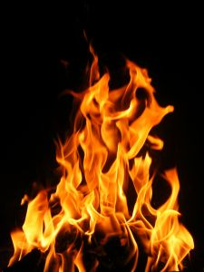
FIRES
Material placement
Training/Drills
Fire Extinguishers
  Hands on training for everyone
EXITS
Where to Go

Slide 3
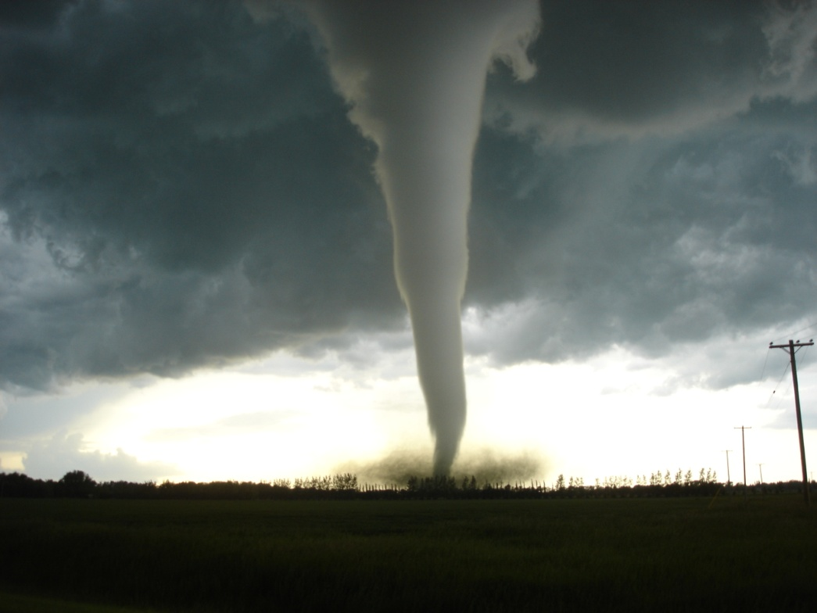
TORNADOES
Keeping track
Where to go
How to warn

Slide 4
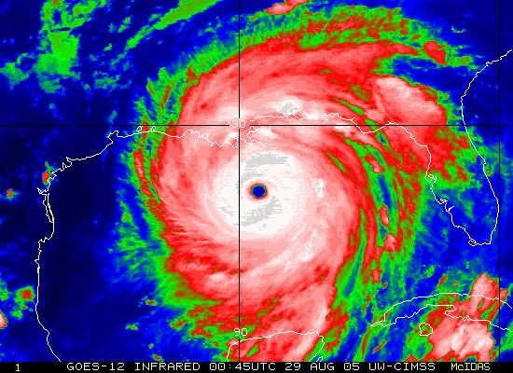
HURRICANES
Time to Prepare
Practice
Water Damage

Slide 5
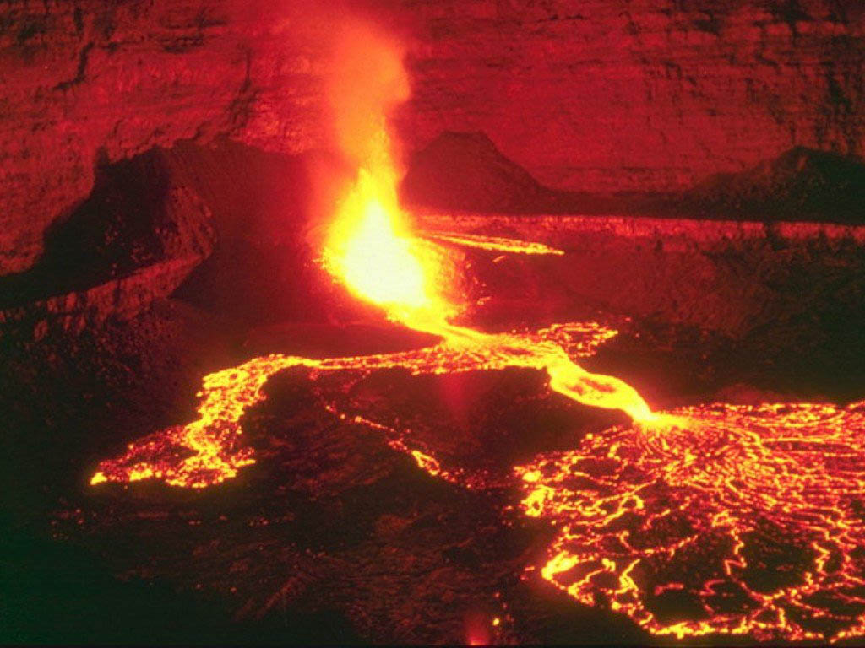
VOLCANOES
“We follow John up that hill.”

Slide 6
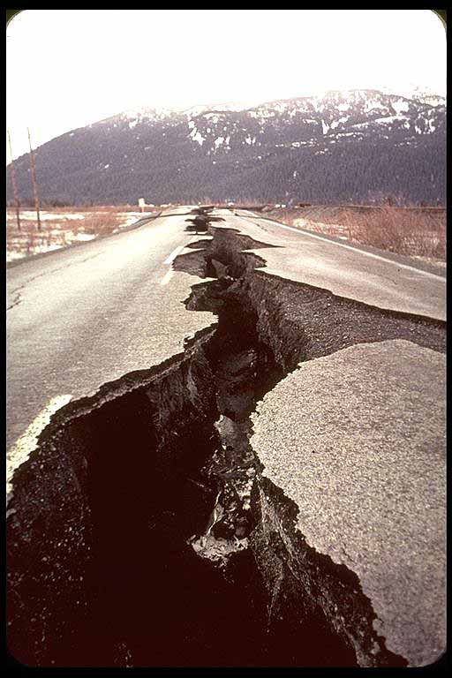
EARTHQUAKES
Material placement
Secure shelving
It’s not what you think

Slide 7
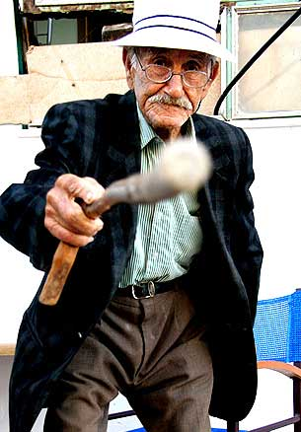
CUSTOMER SECURITY
Sign-in Log for Visitors
Traffic Flow
No Special Privileges
Special Needs

Slide 8
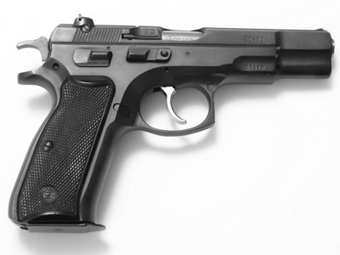
INTERNAL SECURITY
Cashiers and Cash
Cameras
Firearms

Slide 9
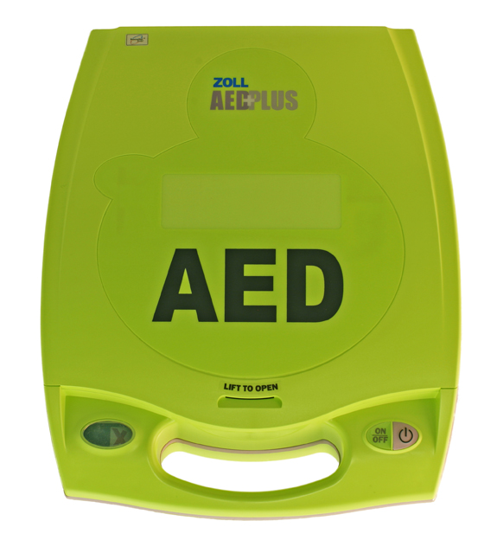
PERSONAL SAFETY
First Aid
CPR
AEDs
BBP

Slide 10
Questions?
Joe Bateman
joebateman@isri.org
202-716-3702

